Slide 1



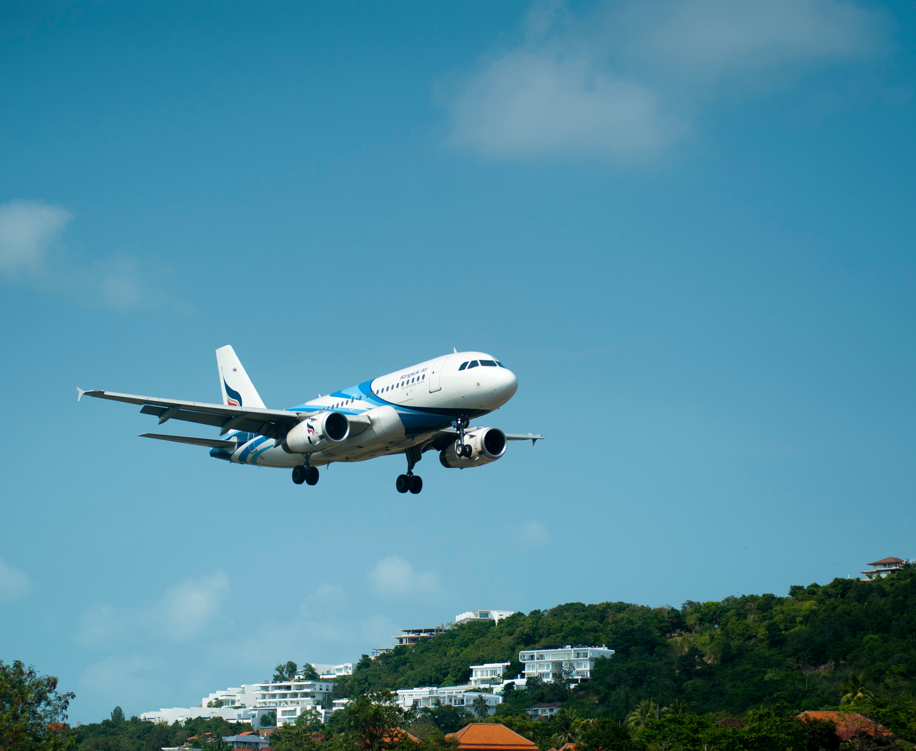

Airline
Codeline AirLine
7/1/2025
Member’s Name:
Tasnim Al-Brashdi
Ibrahim Al-Busaidi
Rashed Al-Ghailani

Slide 2



About Codeline Airlines
Airline
Codeline Airlines is a company specializing in managing aviation operations, starting from user and passenger registration to managing flights, bookings, and customer reviews.
The company serves as a practical example of an integrated system for airline management, demonstrating how to connect various elements such as users, airplanes, airports, and flights seamlessly.

Slide 3



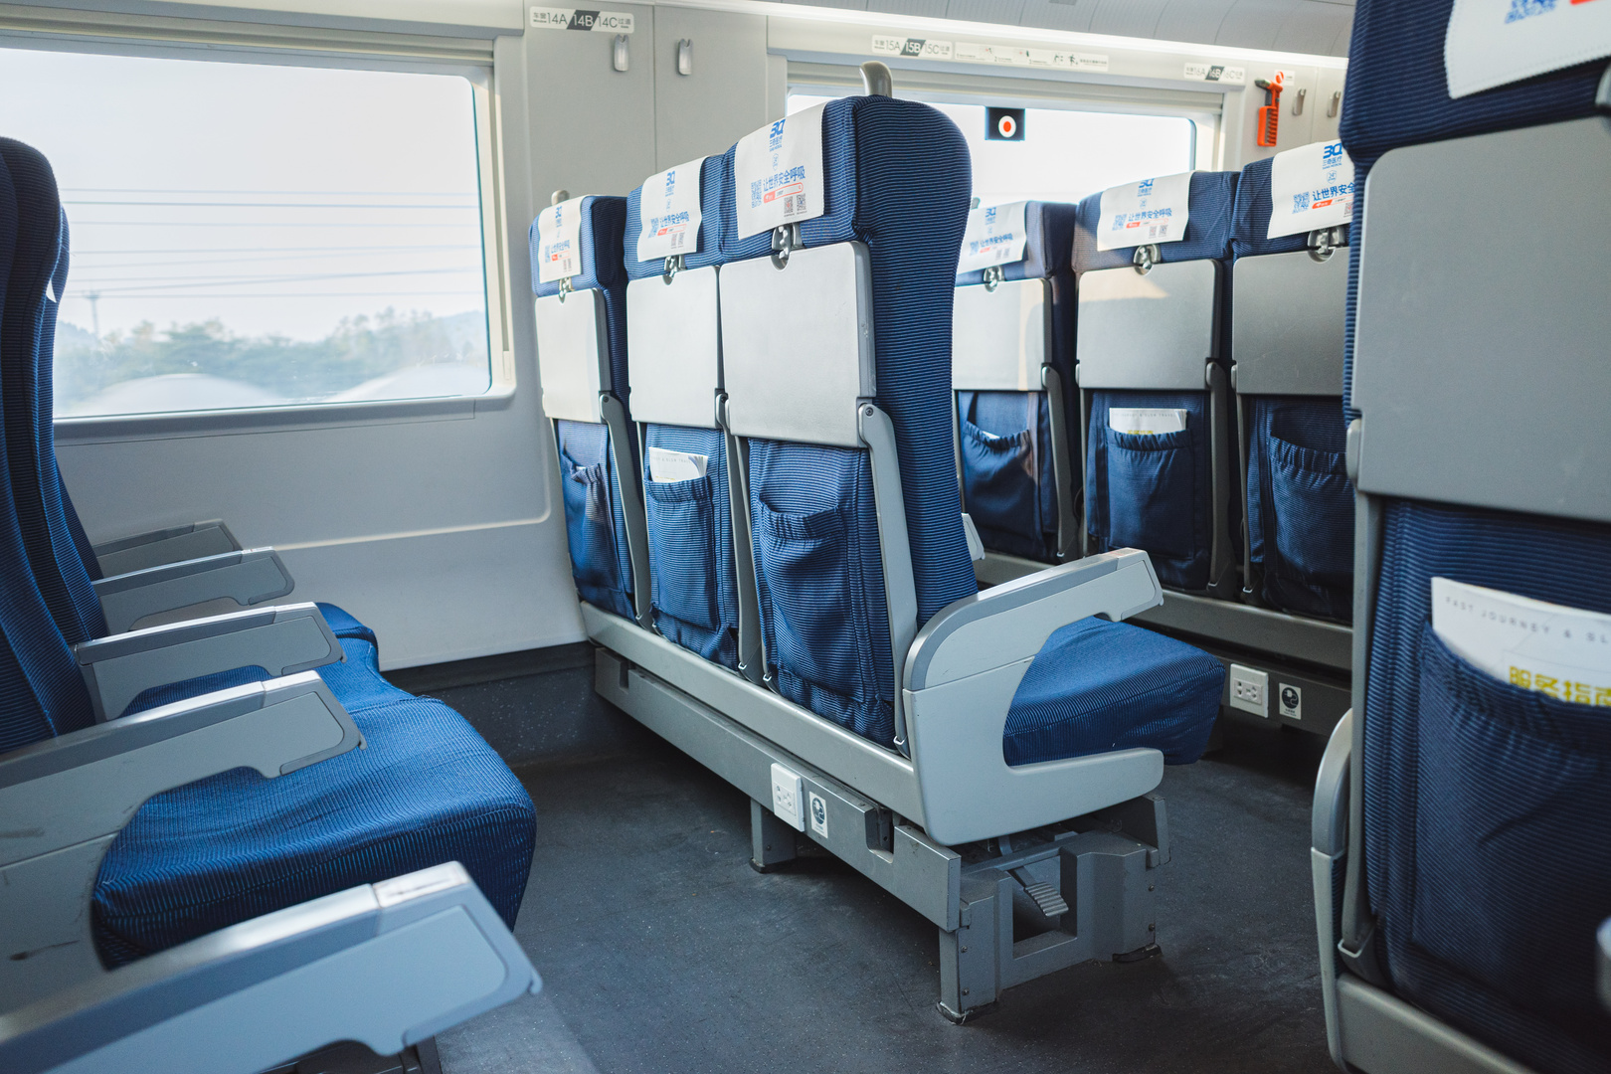

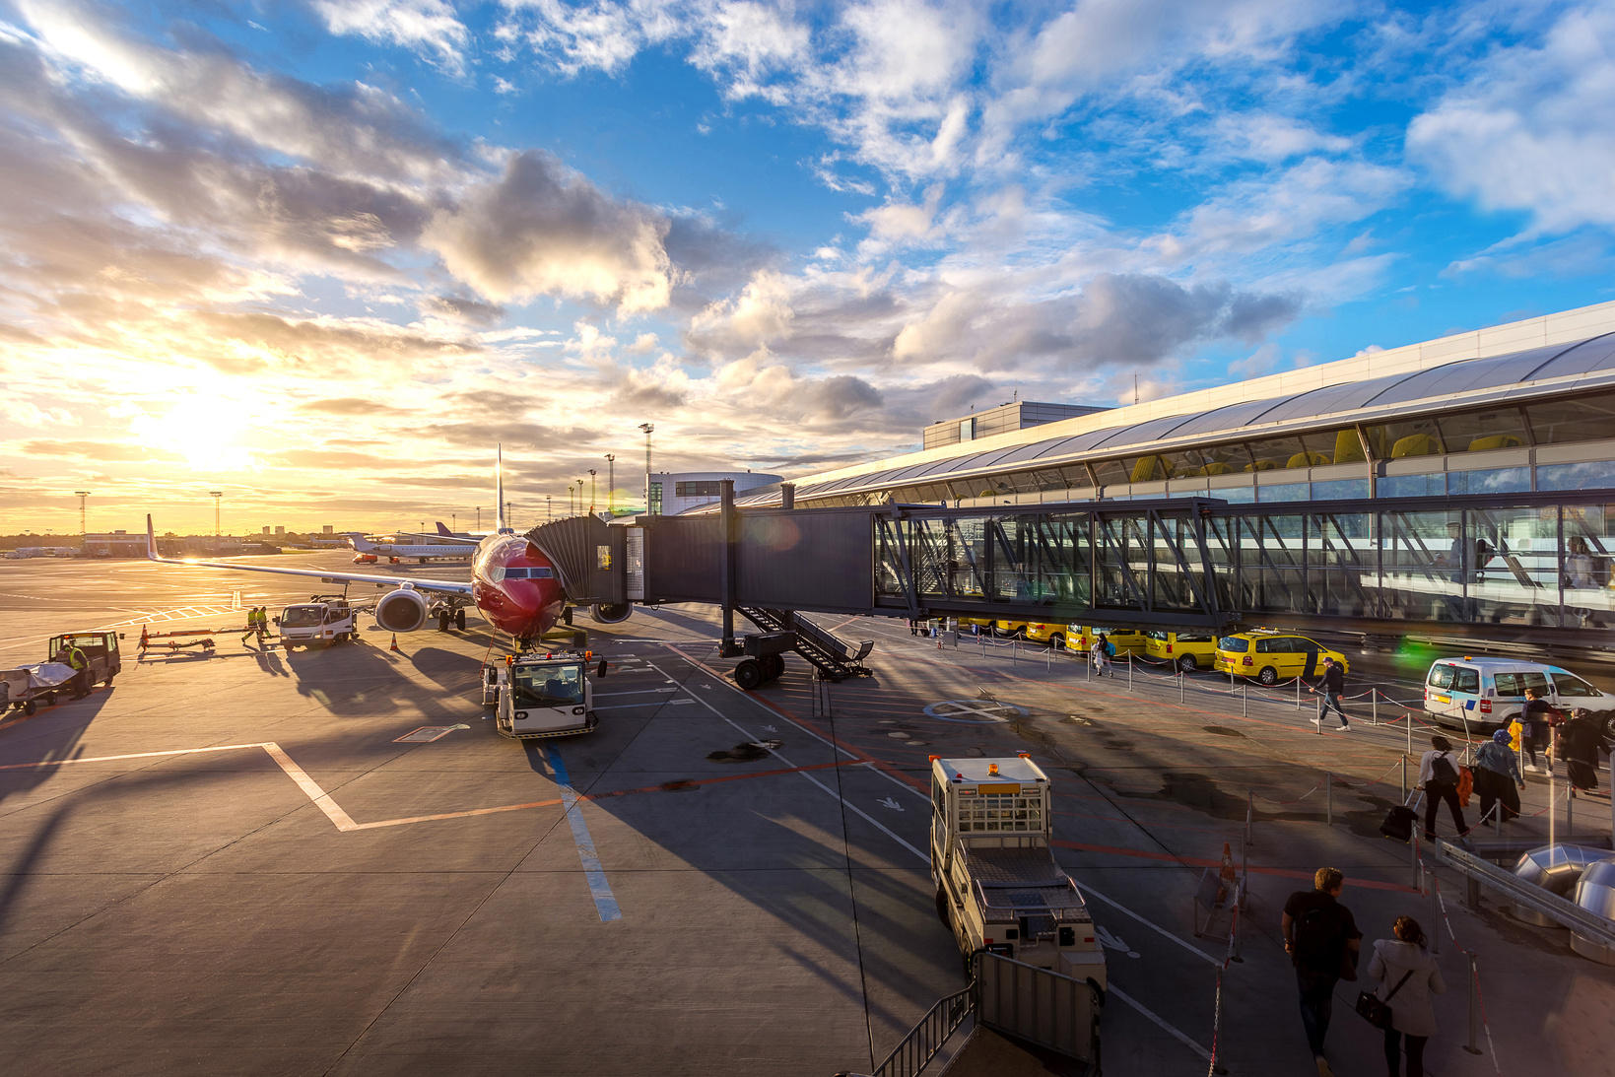
Airline
User Management
Users can register as either "Passengers" or "Admins." An interface is provided that allows users to manage their profiles, book flights, and track loyalty points.

Slide 4
Airline
Aircraft and Seat Management
Each airplane contains detailed information, such as the model, number of seats, and seat types (Economy, Business Class, or First Class).

Slide 5
Airline
Airport Management
The company relies on a network of airports that are registered and managed by administrators.
Each flight includes a departure airport and a destination airport.

Slide 6
Airline
Flight and Booking Management
Flights are scheduled and linked to airplanes and airports.
Bookings include seat selection, ticket cost, and additional services such as meals.

Slide 7
Airline
Customer Experience
Customers can write reviews about their flights, with the option to update or delete their reviews.
An overall rating for each flight is calculated based on passenger feedback.

Slide 8
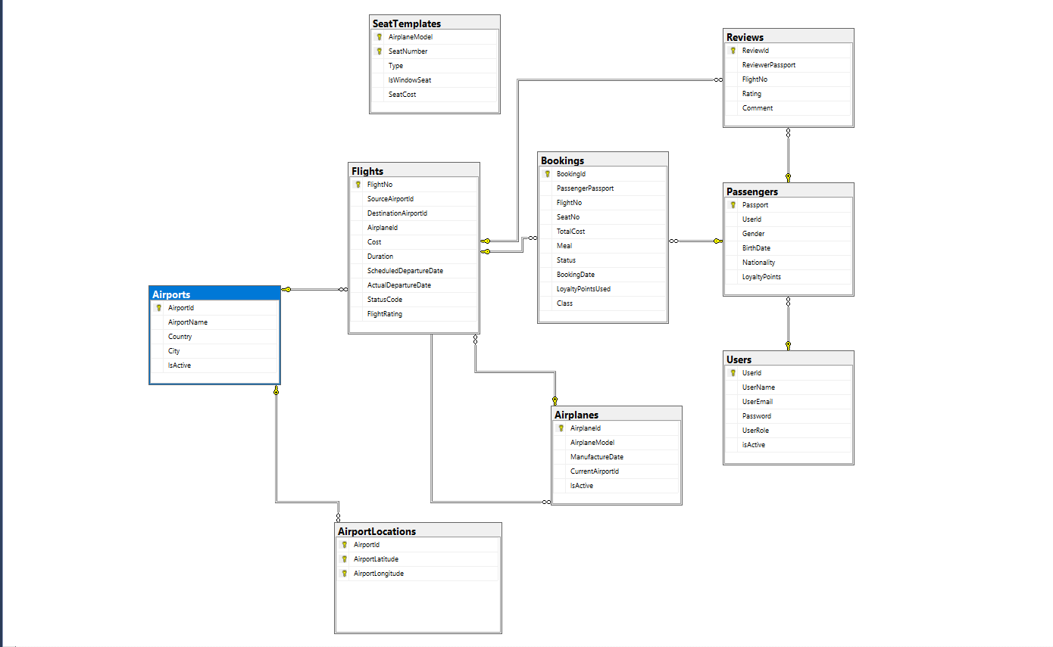



DataBase

